Slide 1
Cleaning Parks for a Safer Future
Connor mattes & Zachary sorenson

Slide 2
What we are doing
Find shortest route between a set number of parks in Denver
Use driving distances rather than “as the crow flies” distances
Travelling Salesman Problem

Slide 3
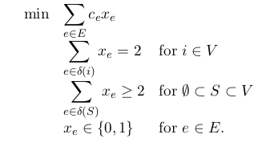
The Integer Program (Travelling Salesman)

Slide 4
Implementation for Exact Solution
Graph with weighted edges (Google Maps)
Coded in Sagemath
Sagemath uses MILP solver (CPLEX)
Does not take into fact we have special properties (metric)

Slide 5
Implementation for Approximate Solution
Christofides’ algorithm
Coordinates rather than Google Maps distances
C+ + code from Github

Slide 6
Christofides’ Algorithm Properties
Approximate best subtour
Optimal with 1.5 of best
Need a metric on graph distances
Distances zero iff points are the same
Distances symmetric
Travelling from park a to c faster than from a to b then b to c (triangle inequality)

Slide 7
Christofides’ Algorithm Steps
Find a minimum spanning tree (Prim’s Algorithm O(n² log n))
Find a minimum perfect matching on odd degree vertices (Micali and Vazirani O(n^{5/2}))
Find Eulerian tour of resulting (multi) graph (Hierholzer’s algorithm O(n²))
Skip over repeated vertices to get a tour (O(n))
Total run time O(n^{5/2})

Slide 8
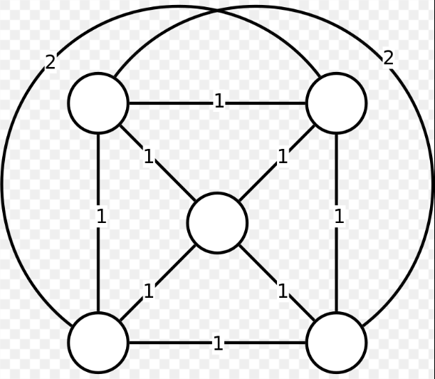
Christofides’ Algorithm [1]

Slide 9
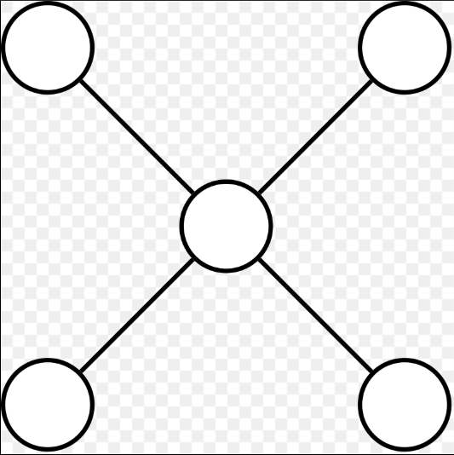
Step 1: Minimum Spanning Tree

Slide 10
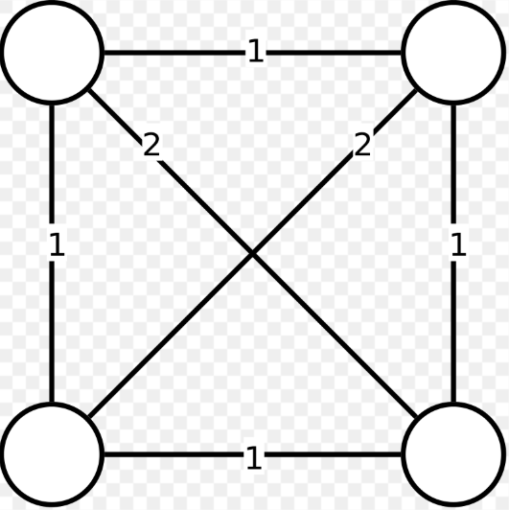
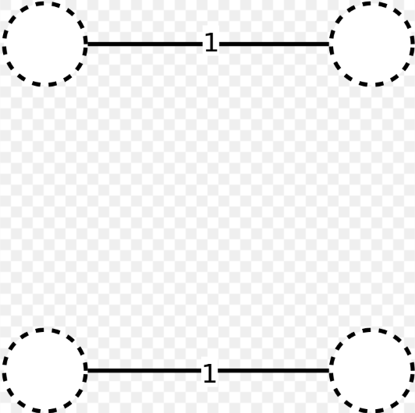
Step 2: Minimum Perfect Matching on Odd Vertices

Slide 11
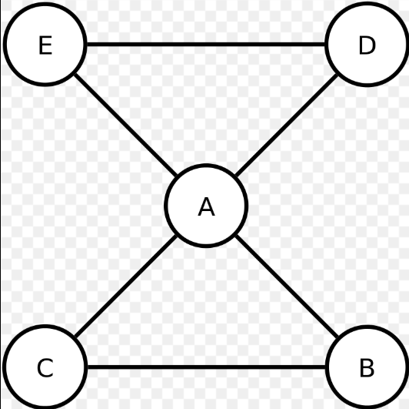
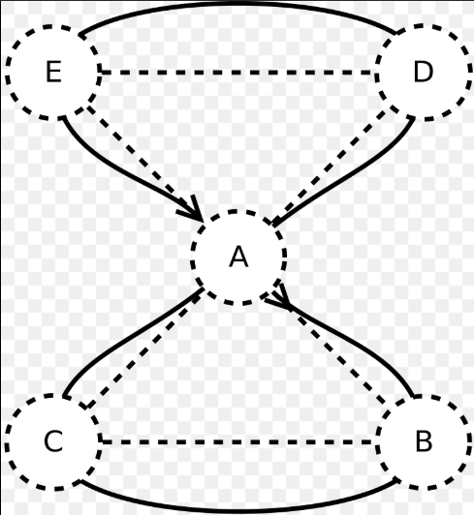
Step 3: Find Eulerian Circuit

Slide 12
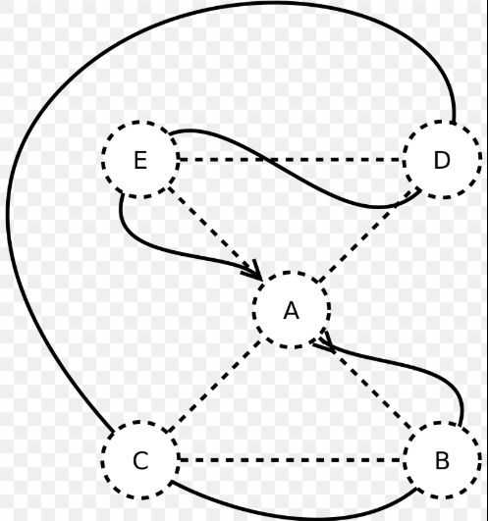
Step 4: Skip Vertices

Slide 13
Proof that solution is within 1.5 of optimum
Let c be optimum value
Idea: Show Eulerian Circuit length at most 1.5c
Works because of triangle – shortcutting only reduces length
Best path minus single edge is spanning tree so minimum spanning tree at most length c

Slide 14
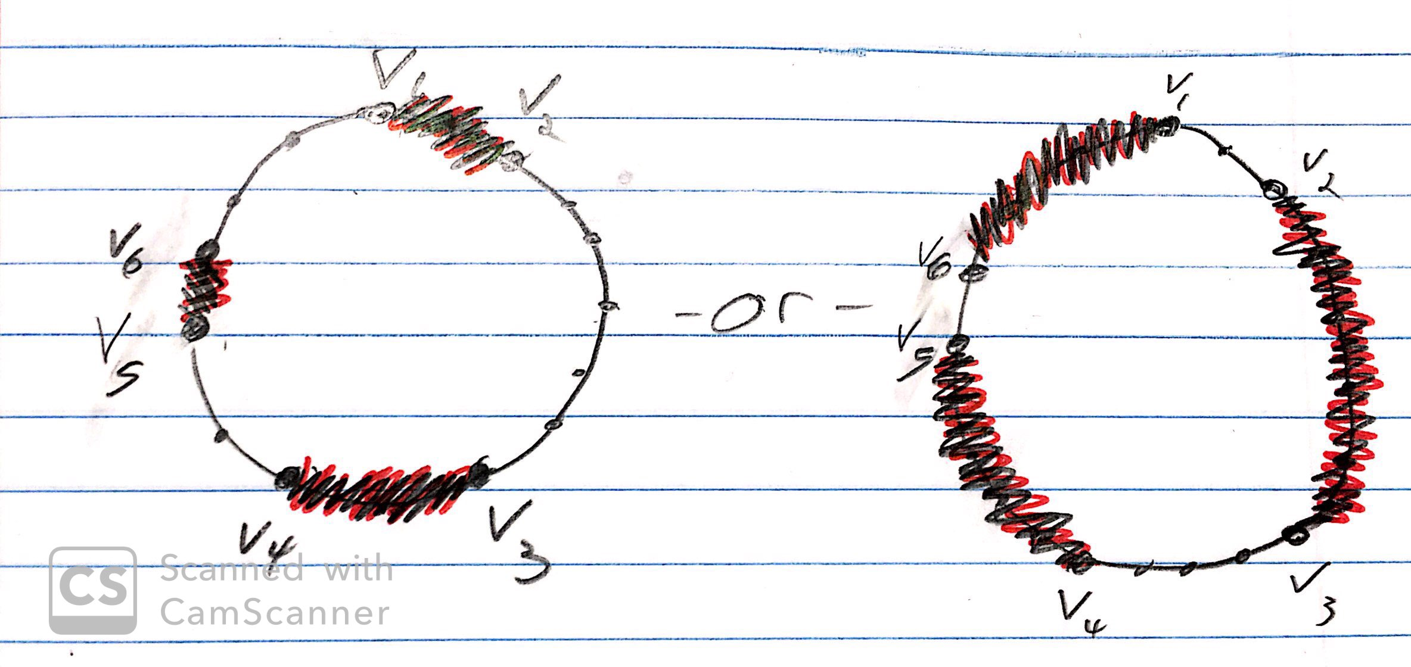
Proof that solution is within 1.5 of optimum (cont.)
Perfect matchings always have total length at most 0.5c
Idea: Order vertices cyclically around best cycle, and go either forwards or backwards, using triangle inequality these sum to c, so one must be at most 0.5c

Slide 15
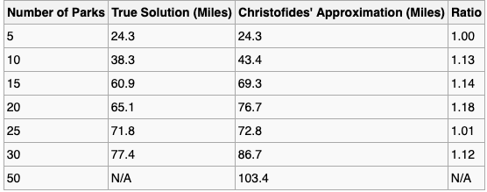
Results

Slide 16
Data:
 | 2 | 3 | 4 | 5 | 6 | 7 | 8 | 9 | 10 | 11 | 12 | 13 | 14 | 15 | 16 | 17 | 18 | 19 | 20 | 21 | 22 | 23 | 24 | 25 | 26 | 27 | 28 | 29 | 30 | 31 | 32 | 33 | 34 | 35 | 36 | 37 | 38 | 39 | 40 | 41 | 42 | 43 | 44 | 45 | 46 | 47 | 48 | 49 | 50
CITY PARK
SLOANS LAKE PARK | 5.7
WASHINGTON PARK | 4 | 7
BERKELEY LAKE PARK | 7.5 | 3.2 | 9.7
RUBY HILL PARK | 8 | 6.4 | 3.2 | 8.8
CHEESMAN PARK | 1.5 | 5 | 3.1 | 8.1 | 5.4
LOWRY SPORTS COMPLEX | 4.8 | 10 | 5.3 | 12.5 | 8.7 | 5.3
BARNUM PARK | 5.8 | 2.4 | 5.1 | 5.6 | 3.8 | 4.3 | 8.9
NORTHFIELD POND PARK | 5.8 | 11.1 | 9.7 | 8.4 | 13.7 | 7.3 | 5.9 | 7.1
HUSTON LAKE PARK | 6.7 | 4.3 | 4 | 7 | 2 | 5.2 | 8.6 | 1.9 | 13.3
SANCHEZ PARK | 4.8 | 1.4 | 5.9 | 4.5 | 5.6 | 4.1 | 9.1 | 1.6 | 10.2 | 3.2
WAGON TRAIL PARK | 13 | 19.7 | 12 | 24.1 | 15.3 | 13.2 | 9.8 | 16.6 | 15.7 | 17.2 | 17
EISENHOWER PARK | 6.4 | 9.8 | 4 | 13 | 5.7 | 6.4 | 6.5 | 8.6 | 17.1 | 7.3 | 8.9 | 10.3
CRANMER PARK | 2.6 | 6.9 | 2.9 | 10.1 | 5.9 | 2.6 | 2.7 | 6.1 | 7 | 5.5 | 6 | 10.9 | 4.4
GARLAND PARK | 4.8 | 10.3 | 2.9 | 12.3 | 8 | 4.5 | 3 | 8 | 7.7 | 6.6 | 7.9 | 9.3 | 3.9 | 2.5
CHERRY CREEK | 1.7 | 6.4 | 2.5 | 9.4 | 5.7 | 1.9 | 4 | 5.6 | 7.4 | 5.1 | 5.6 | 11.5 | 4.7 | 0.8 | 3.1
HARVARD GULCH | 6.5 | 7.5 | 2.6 | 10.1 | 2.6 | 5.1 | 7.8 | 6.3 | 15 | 4 | 6.7 | 13.9 | 3.4 | 5.5 | 5.1 | 5.1
COOK PARK | 5.4 | 10.3 | 3.4 | 14.1 | 6.9 | 5.1 | 3.3 | 8.5 | 8 | 7.2 | 8.4 | 8.6 | 3.7 | 3.1 | 0.8 | 3.6 | 5
CRESTMOOR PARK | 4 | 8.6 | 3.9 | 11.8 | 7.3 | 4.5 | 1.9 | 7.8 | 6.3 | 6.9 | 7.7 | 9.9 | 5.2 | 1.6 | 1.8 | 2.4 | 6.4 | 2.1
HAMPDEN HEIGHTS NORTH PARK | 8.8 | 12.5 | 6.6 | 15.7 | 9.9 | 8.4 | 5.9 | 11.2 | 10.6 | 10 | 11.6 | 7.8 | 4.2 | 6.4 | 4.1 | 6.9 | 6.7 | 3.2 | 5.4
NORTHFIELD ATHLETIC COMPLEX | 5.5 | 9.7 | 5 | 13 | 8.5 | 5.5 | 0.6 | 9 | 6.6 | 8.1 | 8.9 | 9.4 | 6.3 | 3 | 2.8 | 3.8 | 7.6 | 3.1 | 1.7 | 5.7
CONGRESS PARK | 1 | 6 | 2.7 | 8 | 5.7 | 0.7 | 4.1 | 5.2 | 6.7 | 5.3 | 5.1 | 12.2 | 5.4 | 1.5 | 3.8 | 0.7 | 5.3 | 4.3 | 3.2 | 7.7 | 3.9
HERON POND HELLER OPEN SPACE | 4.8 | 7.1 | 9.8 | 4.6 | 10.7 | 5.4 | 9.7 | 8.1 | 6.3 | 9.6 | 6.6 | 21.1 | 14.8 | 7.4 | 10.3 | 6.6 | 11.7 | 10.2 | 9.1 | 16.5 | 9.5 | 5.5
COMMONS PARK | 3.6 | 3.4 | 5.6 | 4.1 | 6.6 | 3.5 | 8.6 | 4.7 | 7.8 | 5.5 | 3 | 21.1 | 10.3 | 5.5 | 7.4 | 5.1 | 7.9 | 8 | 7.2 | 12.7 | 8.4 | 4.3 | 4
BARNUM NORTH PARK | 5.3 | 2.5 | 5 | 5.2 | 3.9 | 3.9 | 8.5 | 0.9 | 10.9 | 2.2 | 1.3 | 20.1 | 8.5 | 5.5 | 7.3 | 5 | 5.7 | 8.3 | 7.5 | 10.8 | 8.7 | 4.2 | 7.1 | 3.9
CITY OF BREST PARK | 2.8 | 6.9 | 2.1 | 10.7 | 5.5 | 2.7 | 4.3 | 6.1 | 9.1 | 4.8 | 6.1 | 11.6 | 3.8 | 1.9 | 2.6 | 2.2 | 4.8 | 3.1 | 2.8 | 6.4 | 4.4 | 2.5 | 7.4 | 5.6 | 6.1
VETERANS PARK | 4.6 | 7.5 | 0.9 | 9.9 | 3.4 | 3.7 | 5.9 | 6.3 | 14.8 | 5.1 | 6.4 | 11.3 | 3.2 | 3.6 | 3.3 | 3.2 | 2.4 | 3.9 | 4.5 | 5.7 | 6.1 | 3.5 | 11 | 7.9 | 6.3 | 2.6
LINCOLN PARK | 3.7 | 2.9 | 4.2 | 5.8 | 4.5 | 2.6 | 7.4 | 2.7 | 10.2 | 3.5 | 1.7 | 18.8 | 8.3 | 4.4 | 6.2 | 3.9 | 5.4 | 6.8 | 6 | 10.1 | 7.2 | 3.1 | 6.3 | 2.2 | 2.7 | 5 | 5.2
NORTHSIDE PARK | 4.7 | 7.1 | 10 | 4.3 | 9.7 | 5.6 | 9.9 | 7.7 | 6 | 8.6 | 6.2 | 20.8 | 12.9 | 7.3 | 9.9 | 6.5 | 10.6 | 10.5 | 9.2 | 14.5 | 9.7 | 5.4 | 0.9 | 3.5 | 7.4 | 8.3 | 10.4 | 5.7
PULASKI PARK | 3.1 | 7 | 2.5 | 10.6 | 5.9 | 2.8 | 3.5 | 6.2 | 8.1 | 5.5 | 6.2 | 11 | 4 | 1.1 | 2.3 | 0.8 | 5 | 2.9 | 2 | 6.6 | 3.5 | 2.5 | 8 | 5.7 | 6.2 | 0.7 | 3.1 | 4.4 | 8.1
UNNAMED 51ST AND ZUNI PARK | 6.2 | 4.8 | 9.8 | 1.9 | 9.5 | 6.1 | 11.6 | 5.7 | 7.5 | 6.9 | 4.4 | 22.3 | 13.4 | 9.2 | 11.4 | 8.3 | 10.7 | 12 | 10.7 | 16 | 11.4 | 6.9 | 3.7 | 3 | 5.7 | 9.9 | 10.5 | 4.8 | 3.1 | 8.8
ROSEDALE PARK, DENVER | 6.7 | 7.4 | 2.7 | 9.9 | 2.5 | 5.2 | 8 | 6.2 | 14.4 | 3.9 | 6.3 | 13.8 | 3.3 | 5.7 | 5.3 | 5.2 | 0.4 | 5.3 | 6.6 | 6.5 | 8 | 5.5 | 10.6 | 7.8 | 5.8 | 4.6 | 2.5 | 6.1 | 10.2 | 5.3 | 10
WEST BAR VAL WOOD PARK | 5.7 | 3.8 | 3.7 | 6.6 | 2.2 | 4.2 | 7.5 | 1.5 | 12.3 | 1 | 2.7 | 16.5 | 6.6 | 4.8 | 5.8 | 4.3 | 4.4 | 6.4 | 6.1 | 9.2 | 7.7 | 4.5 | 8.5 | 4.8 | 1.5 | 4.7 | 4.2 | 2.8 | 8.1 | 4.4 | 6.5 | 4.3
BURNS PARK | 2.7 | 7 | 2.6 | 10.2 | 6 | 2.7 | 3 | 6.2 | 7.7 | 5.6 | 6.1 | 16.5 | 4.1 | 0.5 | 2.1 | 0.9 | 5.2 | 2.7 | 1.6 | 6 | 3.1 | 2.5 | 7.5 | 5.7 | 6.2 | 0.9 | 3.3 | 4.3 | 7.7 | 0.9 | 9.1 | 5.3 | 4.8
ARGO PARK | 4.1 | 6.3 | 9.4 | 3.5 | 9.1 | 5 | 9.4 | 7.2 | 5.4 | 8 | 5.6 | 20.2 | 12.3 | 7.1 | 9.3 | 6.2 | 10.1 | 9.9 | 8.6 | 13.9 | 9.2 | 4.8 | 1.3 | 2.9 | 6.8 | 7.7 | 9.8 | 5.1 | 1 | 7.8 | 2.3 | 9.9 | 7.5 | 7.2
CIVIC CENTER PARK | 2.6 | 3.4 | 3.5 | 6.9 | 4.8 | 1.6 | 6.8 | 3.7 | 8.5 | 4 | 2.5 | 14.4 | 7.2 | 3.7 | 6.5 | 3.3 | 4.7 | 6.2 | 5.4 | 9.8 | 6.3 | 2.4 | 4.7 | 2.1 | 3.7 | 4.3 | 4.8 | 1 | 4.3 | 3.4 | 4.5 | 4.6 | 3.2 | 3.8 | 3.7
MARTINEZ PARK | 5.8 | 1.4 | 6.3 | 4.3 | 5.3 | 5.2 | 9.8 | 1.6 | 12.3 | 3.5 | 1.3 | 19.2 | 9.2 | 6.8 | 8.6 | 6.3 | 7 | 9.2 | 8.4 | 11.8 | 9.6 | 5.5 | 7.8 | 4.2 | 1.6 | 7.4 | 6.8 | 3.1 | 7.5 | 6.4 | 5.4 | 6.9 | 3.1 | 6.8 | 6.9 | 3.5
MARTIN LUTHER KING JR PARK | 4 | 11.1 | 7.9 | 7.9 | 12.3 | 5.5 | 4.9 | 11.1 | 2.2 | 10.4 | 10.3 | 14 | 9.2 | 5 | 5.7 | 5.4 | 10.5 | 6 | 4.3 | 9.3 | 4.7 | 5.6 | 5.7 | 6.9 | 10.8 | 6.2 | 8.5 | 7.7 | 5.4 | 6.2 | 6.8 | 10.6 | 9.8 | 5.6 | 4.8 | 6.6 | 12.2
SUNKEN GARDENS PARK | 3.3 | 3.4 | 3.6 | 6.3 | 4.5 | 2.2 | 6.8 | 3 | 8.8 | 3.7 | 2.6 | 17.2 | 7.6 | 3.8 | 5.6 | 3.3 | 4.8 | 6.2 | 5.4 | 9.5 | 6.6 | 2.5 | 6.3 | 2.1 | 3 | 4.4 | 4.8 | 0.8 | 5.9 | 3.4 | 4.5 | 4.6 | 2.9 | 3.8 | 5.3 | 0.5 | 3.5 | 10.2
SWANSEA PARK | 3.7 | 8 | 6.7 | 5.4 | 10.6 | 4.4 | 8 | 8.6 | 3.9 | 8.7 | 7.1 | 19.1 | 9.6 | 5.7 | 7.9 | 5.4 | 11.5 | 8.5 | 7.2 | 12.8 | 7.8 | 4.3 | 2.1 | 4.4 | 8.6 | 6.4 | 7.3 | 6.6 | 2.6 | 5.9 | 4.3 | 11.4 | 7.9 | 5.8 | 2 | 4.9 | 8.5 | 3.7 | 6.9
GATES CRESCENT PARK | 4.8 | 2.4 | 5.9 | 4 | 6 | 4.1 | 9.8 | 3.3 | 8.8 | 4.6 | 2 | 19.1 | 9.2 | 6 | 7.9 | 5.6 | 7 | 8.5 | 7.7 | 11.8 | 8.9 | 4.8 | 4.9 | 1.2 | 3.3 | 6.7 | 6.7 | 2.1 | 4.6 | 5.7 | 3.3 | 6.8 | 4 | 6.1 | 4 | 2.5 | 3.1 | 8.9 | 2.9 | 5.4
FOUR MILE HISTORIC PARK | 3.8 | 8 | 2.8 | 11.3 | 6.2 | 3.7 | 2.9 | 7.2 | 7.6 | 5.8 | 7.1 | 10.2 | 4.1 | 1.5 | 1.8 | 2.1 | 5.1 | 2.4 | 1.5 | 5.8 | 3 | 3.5 | 8.6 | 6.6 | 7.1 | 1 | 3.4 | 5.3 | 8.8 | 2 | 10.2 | 5.3 | 5 | 1.1 | 8.2 | 4.9 | 7.6 | 5.6 | 4.8 | 6.9 | 7.1
OBSERVATORY PARK | 5.5 | 8 | 2.1 | 10.3 | 3.6 | 4.6 | 6.2 | 6.7 | 15.2 | 5.5 | 6.8 | 10.7 | 1.9 | 3.9 | 3.5 | 4 | 1.6 | 3.5 | 4.8 | 5.8 | 6.3 | 4.3 | 11.4 | 8.3 | 7 | 2.8 | 1.3 | 6.6 | 11 | 3.8 | 11.3 | 1.7 | 4.7 | 3.5 | 10.5 | 5.4 | 7.1 | 8.9 | 5.6 | 9 | 7.3 | 3.5
RUDE PARK | 4.9 | 1.8 | 5.4 | 4.2 | 4.5 | 4.1 | 8.7 | 1.5 | 10.8 | 2.8 | 0.5 | 18.4 | 8.2 | 5.6 | 7.5 | 5.4 | 6.1 | 8.1 | 7.1 | 11 | 8.5 | 4.4 | 7 | 2.9 | 1.5 | 6.3 | 5.9 | 1.3 | 6.6 | 5 | 4.3 | 6 | 2.3 | 5.7 | 6 | 1.9 | 1.3 | 10.9 | 2.2 | 7.5 | 2 | 6.7 | 6.5
SCHAFER PARK | 2.4 | 8.7 | 5.4 | 6.1 | 9.8 | 2.9 | 6.8 | 7.8 | 4.7 | 8 | 5.5 | 19.5 | 8.4 | 4.6 | 6.8 | 4.2 | 7.9 | 7.4 | 6 | 10.7 | 6.6 | 3.1 | 3 | 4.8 | 7.8 | 5.2 | 6.1 | 5.1 | 3 | 4.6 | 4.8 | 8.1 | 7.2 | 4.6 | 2.7 | 3.8 | 8.3 | 2.9 | 5.5 | 1.8 | 5.9 | 5.7 | 6.9 | 5.4
LOWER LAKEWOOD GULCH | 4.7 | 1.7 | 6.1 | 4.2 | 5.8 | 3.8 | 8.6 | 2 | 9.3 | 3.3 | 0.7 | 19 | 8.3 | 5.6 | 7.4 | 5.1 | 6.1 | 8 | 7.3 | 10.9 | 8.4 | 4.1 | 5.5 | 2 | 2 | 6.2 | 5.9 | 1.3 | 5.1 | 5.2 | 4.3 | 6 | 2.8 | 5.7 | 4.5 | 1.8 | 1.8 | 9.4 | 2.1 | 6 | 1.4 | 6.7 | 7.1 | 0.6 | 6.1
GRANT FRONTIER PARK | 7.4 | 7 | 3.5 | 9.5 | 1.6 | 5.9 | 8.7 | 4.9 | 14.4 | 3 | 5.9 | 15.7 | 4.8 | 6.4 | 6 | 6 | 1.7 | 6.3 | 7.3 | 7.9 | 8.8 | 6.3 | 10.5 | 7.4 | 4.9 | 5.3 | 3.2 | 5.7 | 10.2 | 6.1 | 9.6 | 1.5 | 3.6 | 6 | 9.6 | 6.1 | 6.2 | 14.4 | 4.6 | 11.6 | 6.4 | 6.1 | 2.9 | 5.5 | 11.5 | 5.5
MESTIZO CURTIS PARK | 2.6 | 5.3 | 5.8 | 5 | 8 | 2.4 | 7.7 | 6.1 | 6.1 | 6.2 | 4.4 | 21 | 9.2 | 5.2 | 7.3 | 4.5 | 6.8 | 7.8 | 6.9 | 11.7 | 7.5 | 3.3 | 2.8 | 2.2 | 6.1 | 5.8 | 6.8 | 3 | 2.4 | 4.8 | 3.9 | 6.6 | 5.4 | 5.3 | 1.8 | 2.4 | 7.6 | 4.3 | 3.3 | 2.7 | 3.4 | 6.4 | 7.3 | 5.1 | 1.5 | 4.1 | 8.4
OVERLAND POND PARK | 7.7 | 6.1 | 2.6 | 8.5 | 0.6 | 4.9 | 10.1 | 3.9 | 13.4 | 2 | 4.9 | 16.3 | 5.6 | 5.4 | 6.5 | 5 | 2.1 | 5.8 | 6.8 | 8.1 | 9.2 | 6.5 | 9.5 | 5.9 | 3.9 | 4.5 | 2.8 | 4.7 | 9.2 | 5 | 9.5 | 1.9 | 2.5 | 5.5 | 8.6 | 4 | 5.3 | 13.5 | 3.7 | 10 | 5.5 | 5.7 | 3 | 4.6 | 10.5 | 4.5 | 1.3 | 7.3
GLOBEVILLE LANDING PARK | 3.5 | 6.4 | 6.6 | 3.8 | 9 | 3.5 | 8.5 | 7.1 | 5.4 | 7.2 | 5.5 | 20.2 | 12.2 | 6.2 | 8.4 | 5.3 | 7.8 | 9 | 7.6 | 14.7 | 8.2 | 4.2 | 1.6 | 2.6 | 6.7 | 6.8 | 7.2 | 5 | 1.3 | 5.8 | 2.8 | 7.6 | 6.4 | 6.2 | 0.7 | 3.4 | 6.9 | 5.1 | 4.7 | 2.1 | 3.6 | 7.4 | 10.3 | 5.3 | 1.6 | 4.3 | 9.4 | 1.3 | 8.4

Slide 17
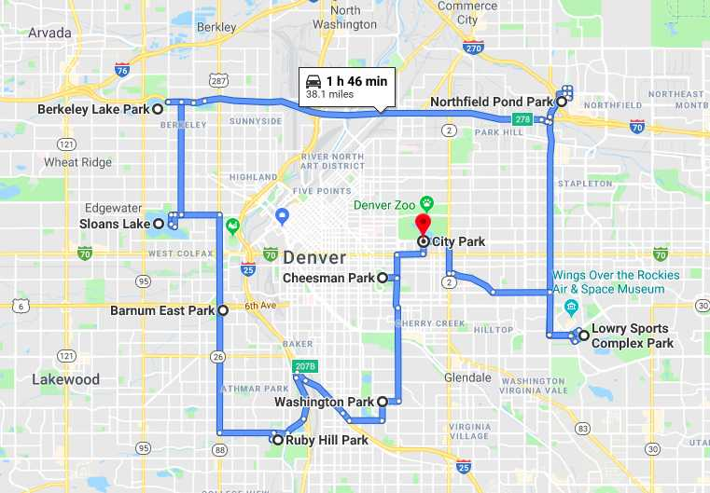
RESULTS:
Order of Shortest Path:
CITY PARK
CHEESMAN PARK
WASHINGTON PARK
RUBY HILL PARK
HUSTON LAKE PARK
BARNUM PARK
SLOANS LAKE PARK
BERKELEY LAKE PARK
NORTHFIELD POND PARK
LOWRY SPORTS COMPLEX
CITY PARK
Total Distance:
38.1 mi

Slide 18
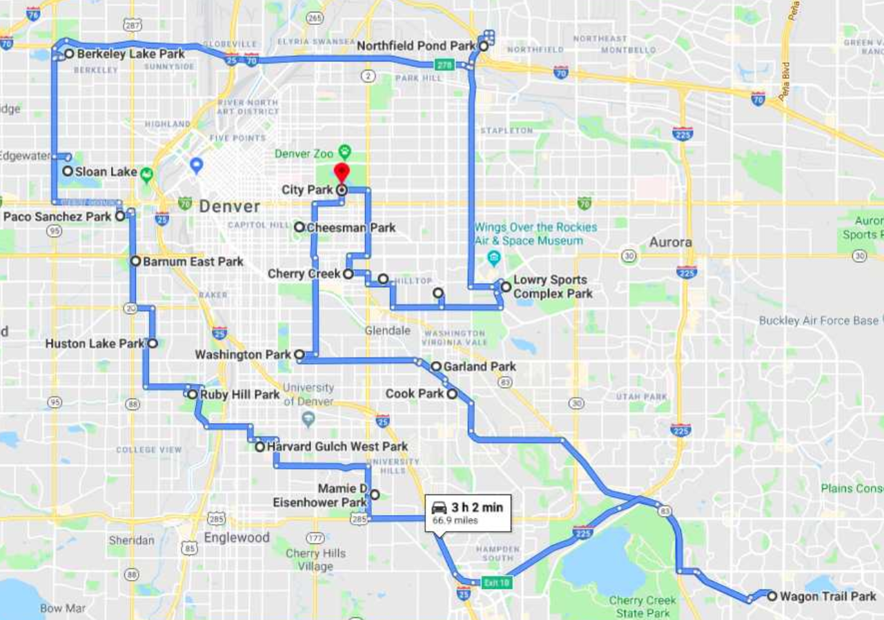
Results:
Total Distance:
66.9 Miles
Total Time:
3 hours 2 min
(Without Traffic)

Slide 19
Suggestions From the Symposium
Just let Google Maps do it
Subtours
Research Current Policies:
Denver Parks & Recreation 201 West Colfax Ave, Dept. 601 Denver, CO 80202
Time

Slide 20
Original Formulation:

Slide 21

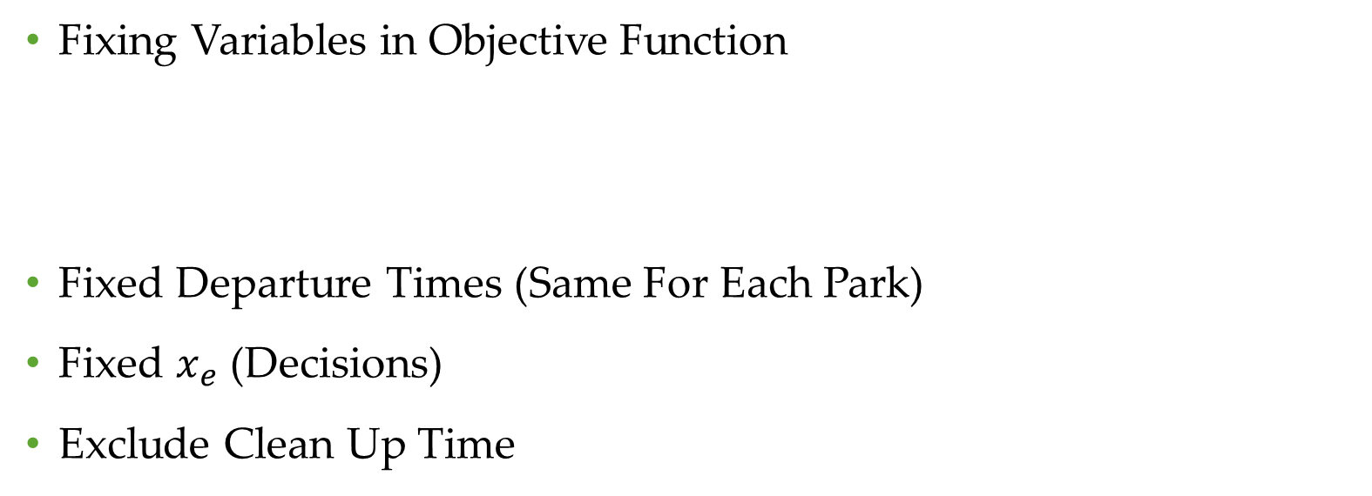
Model Simplification
Fixing Variables in Objective Function
Fixed Departure Times (Same For Each Park)
Fixed $x_{e}$ (Decisions)
Exclude Clean Up Time

Slide 22
Decomposed Results for Time
Departure Time: | 9:00 AM |  | 11:00 AM |  | 4:00 PM
 | Lower B | Upper B | Lower B | Upper B | Lower B | Upper B
CITY PARK
CHEESMAN PARK | 5 | 10 | 6 | 14 | 6 | 14
WASHINGTON PARK | 9 | 16 | 9 | 18 | 10 | 20
RUBY HILL PARK | 10 | 16 | 10 | 18 | 10 | 22
HUSTON LAKE PARK | 7 | 7 | 7 | 7 | 6 | 9
BARNUM PARK | 6 | 10 | 6 | 10 | 6 | 12
SLOANS LAKE PARK | 8 | 14 | 8 | 14 | 9 | 18
BERKELEY LAKE PARK | 7 | 12 | 7 | 14 | 8 | 20
NORTHFIELD POND PARK | 12 | 20 | 12 | 18 | 16 | 28
LOWRY SPORTS COMPLEX | 14 | 35 | 14 | 35 | 18 | 45
CITY PARK | 10 | 22 | 10 | 22 | 12 | 28
Total Time:
Minutes | 88 | 162 | 89 | 170 | 101 | 216
Hours:Minutes | 1:28 | 2:02 | 1:29 | 2:50 | 1:41 | 3:36

Slide 23
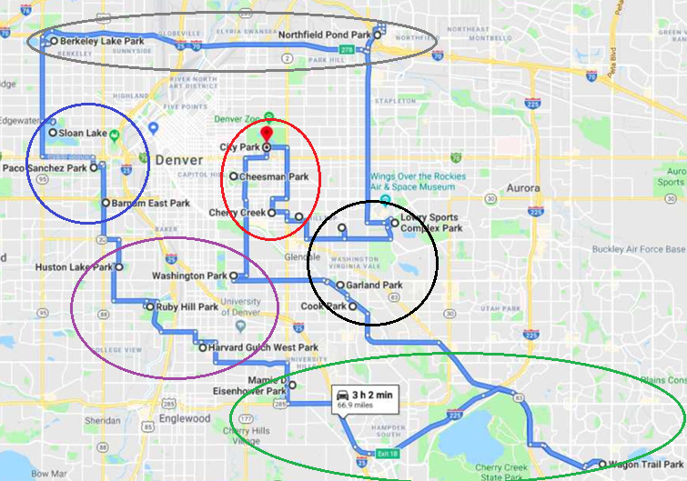
Subtours
Subtour Number: | Park Order: | Distance(mi): | Times(min):
1 | 1 - City Park, Cheesman Park, Congress Park, Cranmer Park, Cherry Creek | 8 | 32
2 | 2- Lowry Sports Complex, Cook Park, Garland Park, Crestmoor Park, Northfield Athletic Complex | 7.8 | 27
3 | 3- Wagon Trail State Park, Hampden Heights North Park, Eisenhower Park | 24.4 | 48
4 | 4- Harvard Gulch, Washington Park, Huston Lake Park, Ruby Hill Park, | 10.9 | 39
5 | 5- Barnum Park, Sanchez Park, Sloans Lake Park | 6.7 | 19
6 | 6- Berkley Lake Park, Commons Park, Heron Pond Heller Open Space, Northfield Pond Park | 24.4 | 41

Slide 24
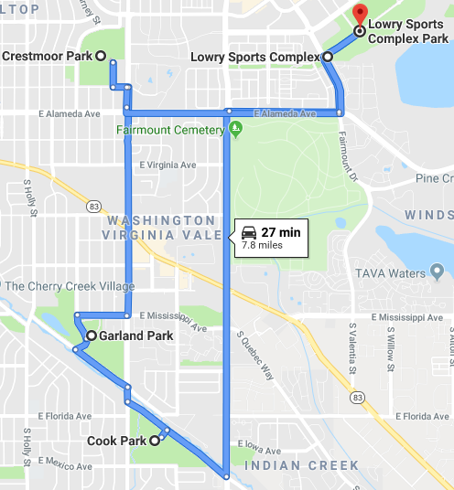
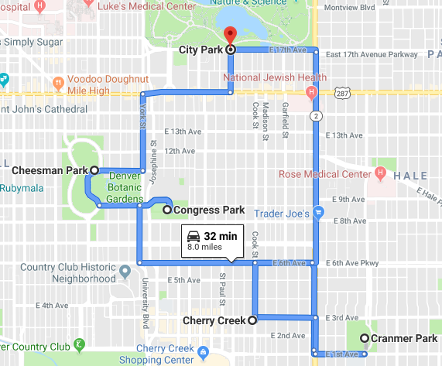
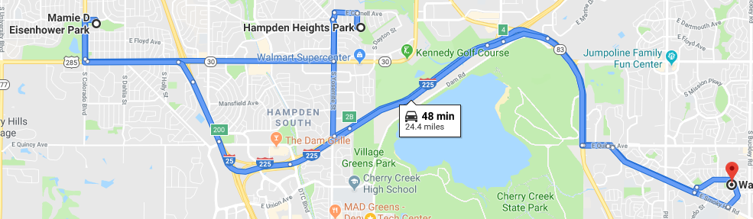
Subtours
Tour 2:
Tour 1:
Tour 3:

Slide 25
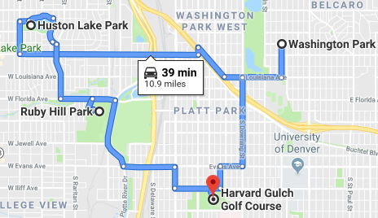
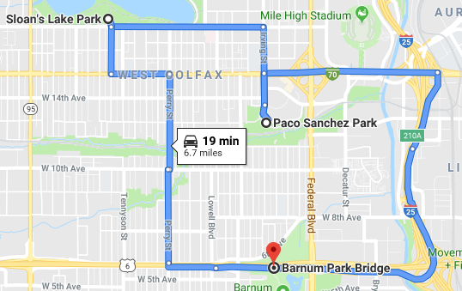
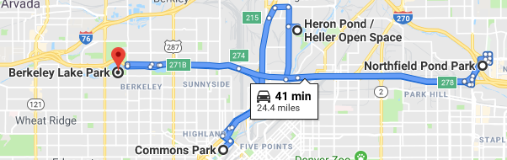
Subtours
Tour 4:
Tour 5:
Tour 6:

Slide 26
Further Extensions and Conclusion
Automation of both getting distances from Google Maps, and using distances in algorithm
Visualization with Google Maps using more than 24 parks
Look at different cities

Slide 27
References
[1] en.wikipedia.org/wiki/Christofides_algorithm

